Slide 1
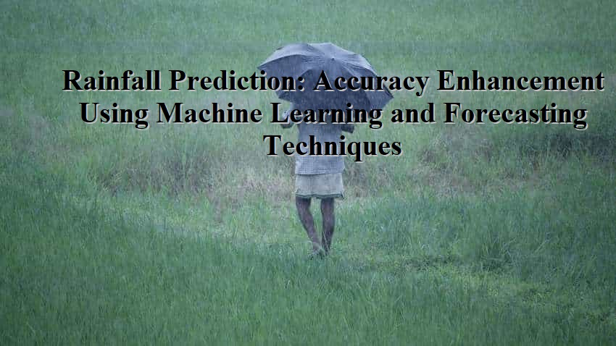

Slide 2
Overview
Abstract
Introduction
Why rainfall Prediction is required?
Existing techniques of rainfall prediction and their limitations
Proposed scheme
Results
Conclusion
Python Libraries
References

Slide 3
Abstract
India’s revenue heavily dependent on agriculture and agricultural growth is heavily dependent on Rain/Precipitation so its mandatory to effectively predict the quantity of rainfall in future time so farmers can plan sowing and other agricultural works based on that prediction.
So author of this paper evaluating the performance of various machine learning algorithms such as SVM, ARIMA, Neural Networks and many more to predict/forecast rainfall and then enhancing accuracy of best performing model.

Slide 4
Introduction
In agribusiness Majority is depends on precipitation in India, where the as its standard wellspring of water, the time and measure of precipitation hold high importance and can impact the entire economy of the nation.
Climate plays a vital role in our everyday life.
From the earliest starting point of the human development, we are occupied with thinking about climatic changes.
Weather forecasting is one of the most challenging issues seen by the world, in a most recent couple of century in the field of science and technology.
Prediction is the phenomena of knowing what may happen to a system in the near future.
As India's economy significantly depends on horticulture, precipitation plays an important part

Slide 5
Why Rainfall prediction required?
Rainfall prediction is important as heavy rainfall can lead to many disasters.
The prediction helps people to take preventive measures and moreover the prediction should be accurate.
There are two types of prediction short term rainfall prediction and long term rainfall.
Rainfall forecasting is very important because heavy and irregular rainfall can have many impacts like destruction of crops and farms, damage of property so a better forecasting model is essential for an early warning that can minimize risks to life and property and also managing the agricultural farms in better way

Slide 6
Besides disease, rainfall can also determine how fast a crop will grow from seed, including when it will be ready for harvesting.
A good balance of rain and proper irrigation can lead to faster-growing plants, which can cut down on germination time and the length between seeding and harvest.
Unseasonably high temperatures on the farm may result in poorer plant productivity and an increase in pests.
To safeguard the farm and crops from insects, pests, and disease control is necessary.
Farmers can use weather forecasts to choose when to apply pesticides and insecticides to avoid crop loss. Classifying the rainfall gives us the good classification accuracy but our ultimate goal is to predict the rainfall using the other forecasted parameters.

Slide 7
Existing techniques of rainfall prediction and their limitations
Astrology
By meteorological department experts
Study of clouds
Using SVM, ARIMA, Neural Networks.
Rainfall prediction has been the one of the most challenging issue around the world in last year. Widely used techniques for prediction are Regression analysis, clustering, and Artificial Neural Network (ANN) .

Slide 8
Limitations/ Drawbacks of Existing Method
Less accuracy
For experts it taking more time and even cost
Expert to expert results may vary

Slide 9
Proposed Method
In proposed method we are going to predict rainfall using ,
Different ML techniques are used for rainfall prediction based on environmental data
Random forest and decision tree are working better

Slide 10
Proposed method block diagram
Upload Rainfall dataset
Pre-process dataset (Train_test_split)
Existing Algorithms ( SVM/KNN/Random forest)
Proposed Method (decision Tree/Random Forest)
Performance Analysis (RMSE and Accuracy)

Slide 11
The data is partitioned into two parts 70% for training and 30% for testing. Four different machine learning techniques like a decision tree, random forest, KNN, SVM were applied on the partitioned data.
For these project we used Random Forest and Decision Tree machine learning classifiers.
The correlation of the rainfall with minimum temperature, maximum temperature, relative humidity and wind It is found that all four parameters have significant importance with the rainfall speed were calculated.
Relative humidity and wind speed were retrieved from minimum temperature and maximum temperature using linear regression and support vector regression as it is found that it gives better accuracy by this method compared to a direct forecast of the individual.

Slide 12
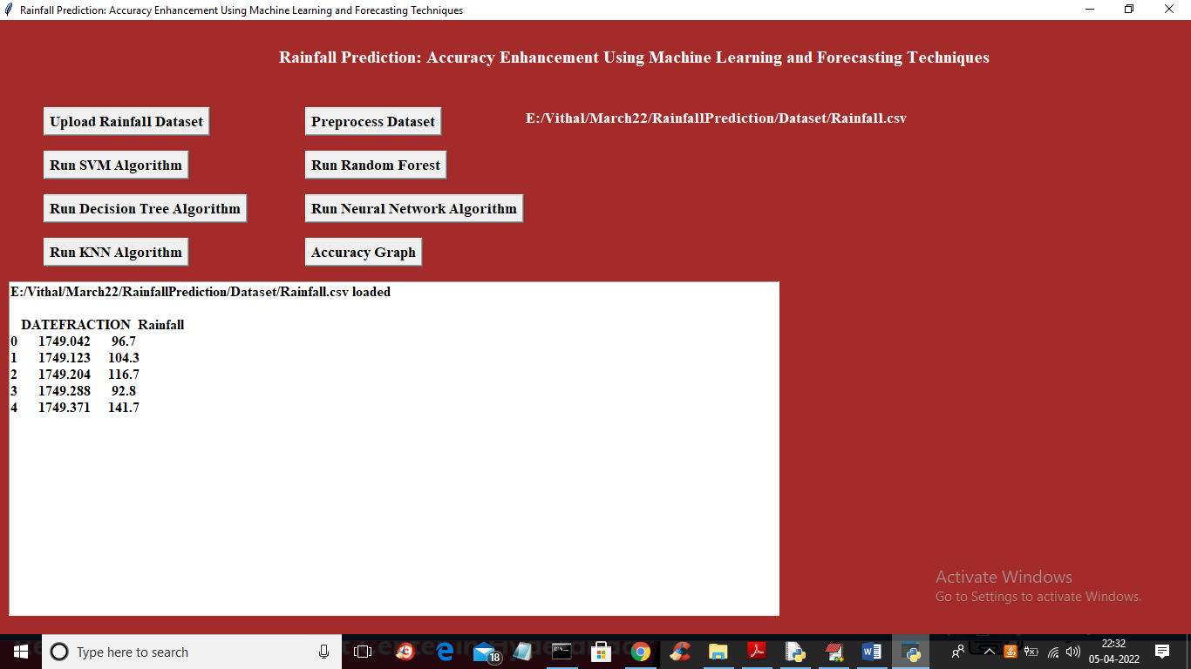
RESULTS: a) Select Dataset

Slide 13

Preprocessing

Slide 14
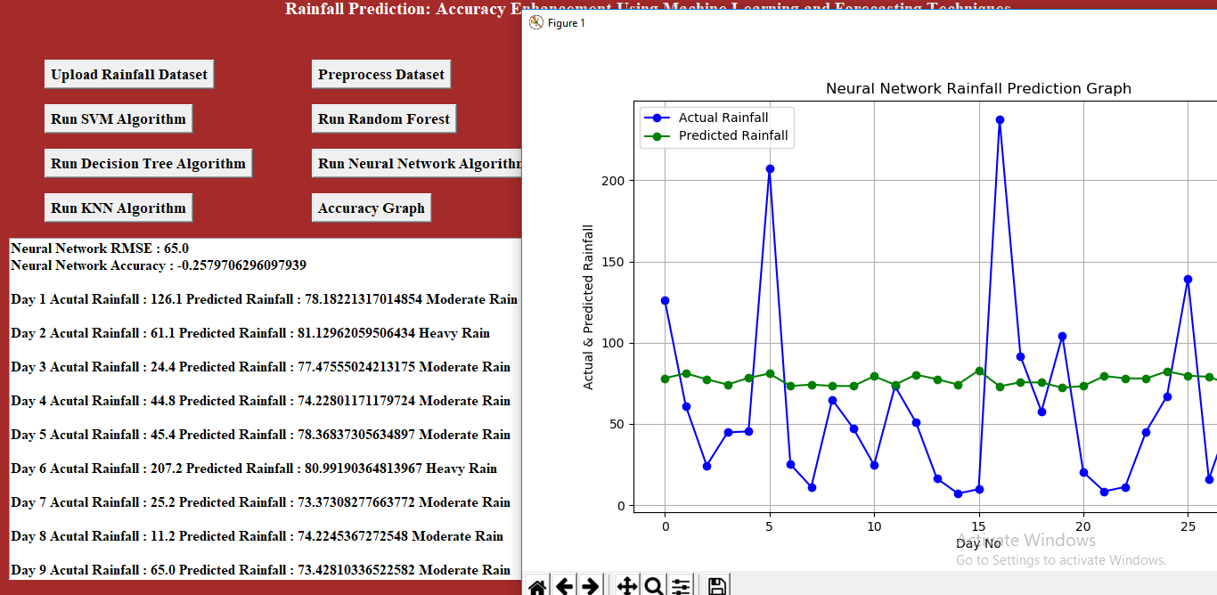
Neural Network for prediction

Slide 15
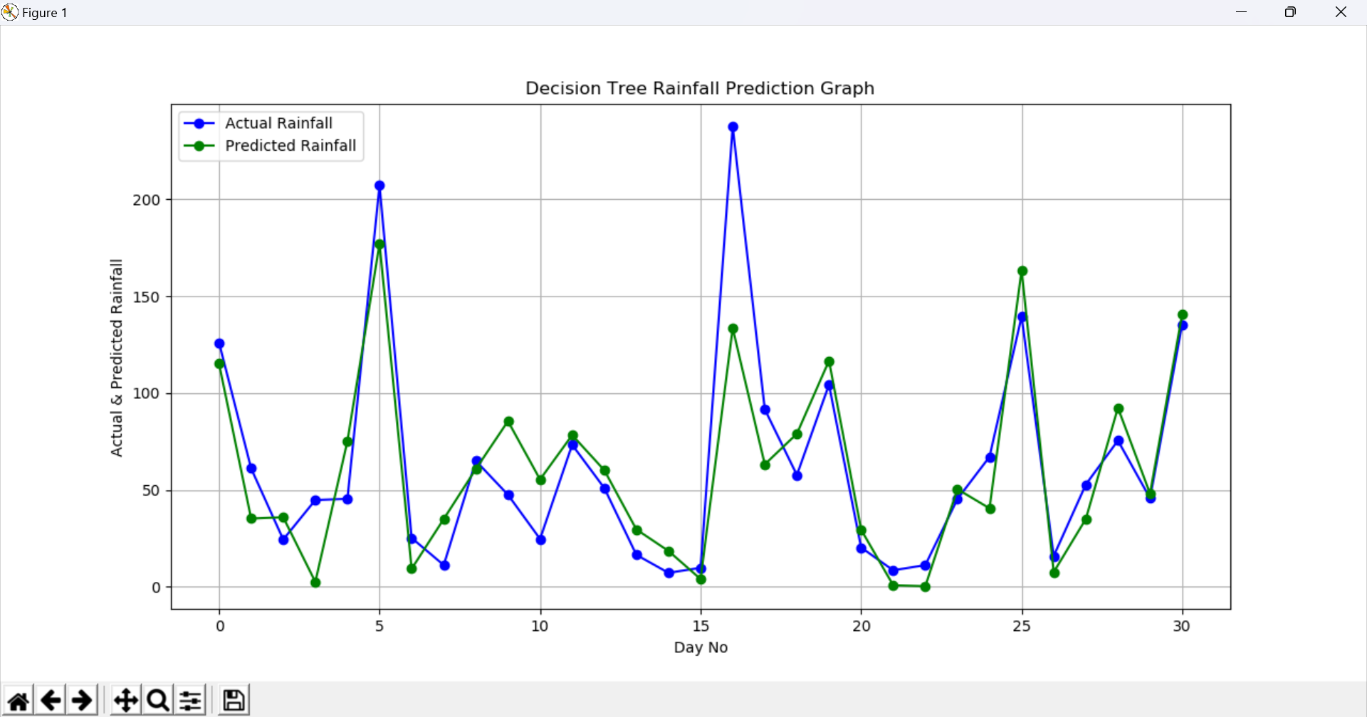
DT for prediction

Slide 16
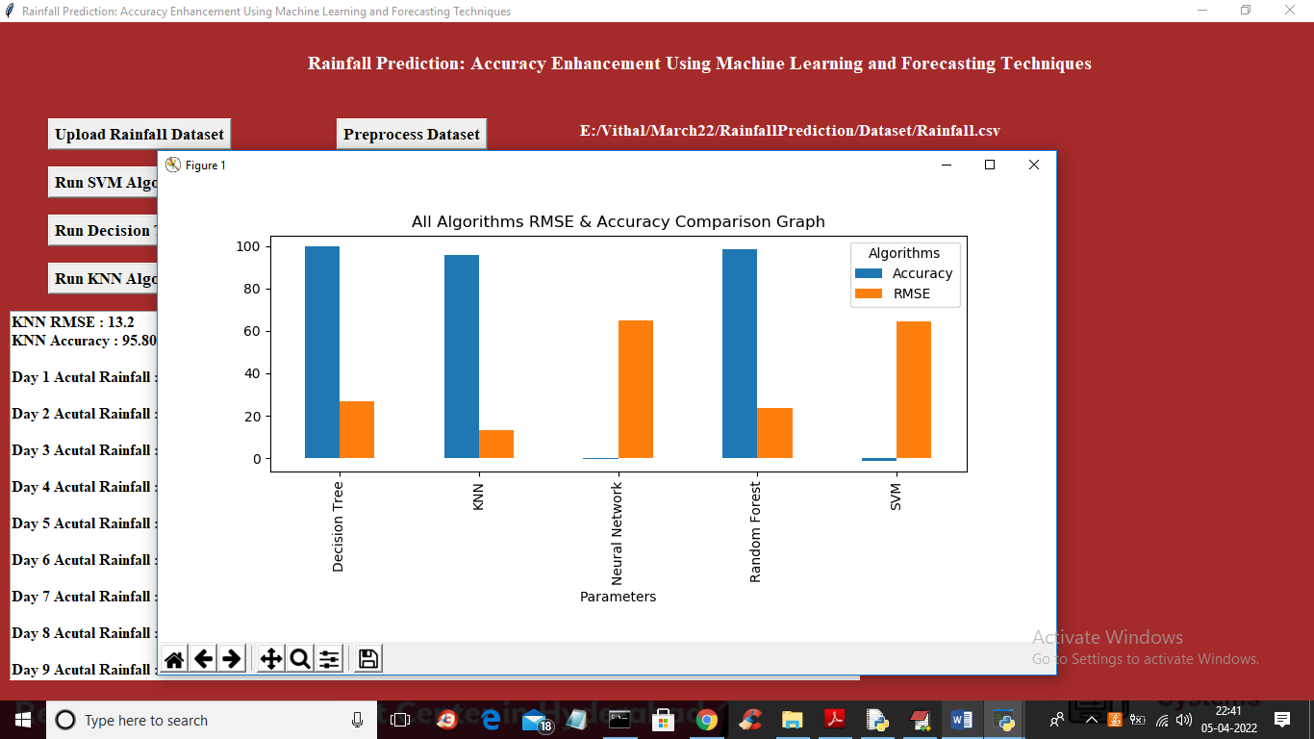
Performance Analysis of Rainfall prediction using different ML techniques

Slide 17
Conclusion
By using various machine learning and forecasting techniques we proposed a work to attempt forecast rainfall.
Rainfall is dependent on different parameters we a better accuracy using limited parameter.
In all algorithms Decision Tree and Random Forest gave high accuracy and outperform other algorithms.
Validations for forecasted parameters are done using RMSE measure. A study can also be done using more observations for particular region or area, and design this kind of model on big data framework so that computation can be faster with higher accuracy.

Slide 18
Python Libraries
NumPy: It is a Python library used for working with arrays. It also has functions for working in domain of linear algebra, Fourier transform, and matrices. NumPy was created in 2005 by Travis Oliphant. It is an open source project and you can use it freely.
Pandas : It is an open source library in Python. It provides ready to use high-performance data structures and data analysis tools.Pandas module runs on top of NumPy and it is popularly used for data science and data analytics.
Matplotlib: It is a python library used to create 2D graphs and plots by using python scripts. It has a module named pyplot which makes things easy for plotting by providing feature to control line styles, font properties, formatting axes.
SKLEARN
Tensor Flow: It is a Python library for fast numerical computing created and released by Google. It is a foundation library that can be used to create Deep Learning models directly or by using wrapper libraries that simplify the process built on top of Tensor Flow.

Slide 19
Thank You

